Slide 1


From IT Foundations to Business Analysis: Bridging Technology and Business Value
Business analysis aligns technological solutions with organizational goals, driving innovation and delivering value.
Core Skills
Navigating Challenges
Requirements elicitation and IT foundations ensure tangible business outcomes.
Business analysts adapt to dynamic environments for project success.
Empowering Professionals
Mastering IT and business analysis empowers professionals to deliver solutions and value.

Slide 2

Introduction to IT and Business Systems
Understanding the intricate relationship between Information Technology (IT) and business systems is foundational for any aspiring business analyst. This section explores how technology underpins all modern business operations, from daily transactions to strategic decision-making.
Why it Matters
Key Concepts
IT is no longer just a support function; it's an integral component that drives business strategy, enables innovation, and creates competitive advantages. For business analysts, a deep appreciation of IT's role is crucial for identifying opportunities and mitigating risks.
Interconnectedness of systems
Technology as an enabler
Data flow and architecture
Digital transformation impact

Slide 3


What is Information Technology?
Information Technology (IT) encompasses the use of computers, storage, networking, and other physical devices, infrastructure, and processes to create, process, store, secure, and exchange all forms of electronic data. It plays a pivotal role in today's interconnected global economy.
Hardware
Software
Physical components like servers, computers, and mobile devices.
Applications, operating systems, and programs that enable hardware functionality.
Networks
Data Management
Systems connecting devices for data sharing and communication.
Storing, organizing, and securing information effectively.

Slide 4


IT vs. Computer Science: A Clear Distinction
Information Technology (IT)
Computer Science (CS)
IT focuses on the practical application and management of technology within organizations. Professionals in IT typically handle the deployment, maintenance, and operation of computer systems, software, and networks to support business functions.
Computer Science is a more theoretical and academic field, concentrating on the fundamental principles of computation, algorithms, and data structures. CS professionals design and develop new software, hardware, and innovative solutions.
Installation & maintenance
System administration
Network management
User support
Algorithm design
Software development
Artificial intelligence
Theoretical computation

Slide 5

Core Components of IT Infrastructure
A robust IT infrastructure is the backbone of any modern enterprise. Understanding its core components is essential for business analysts to identify system dependencies, potential bottlenecks, and areas for improvement.
Hardware
Software
Servers, storage, and endpoints
Operating systems and applications
Networks
Data
Connectivity, routers, and security
Databases, backups, and analytics
These interconnected components work in synergy to enable digital operations, facilitate communication, and manage critical information assets within an organization. A breakdown in any one area can have significant ripple effects.

Slide 6

Computer Hardware: The Physical Foundation
Computer hardware refers to the physical components of an IT system. From powerful servers to everyday workstations, hardware provides the tangible infrastructure upon which all software and data operations rely. Its reliability and performance directly impact business continuity and efficiency.
Key Elements
1
Servers: Centralized computers providing services to other computers.
Workstations: High-performance computers for individual users.
Networking Devices: Routers, switches, and firewalls that connect systems.
Storage Devices: Hard drives, SSDs, and cloud storage solutions.
Performance
Ensuring sufficient processing power and memory.
2
Reliability
Minimizing downtime and hardware failures.
3
Scalability
Ability to expand and adapt to growing needs.

Slide 7
Computer Software: Driving Digital Functionality
Software is the set of instructions, data, or programs used to operate computers and execute specific tasks. It translates user commands into actions, enabling everything from word processing to complex data analytics. Business analysts must understand software capabilities and limitations to define effective solutions.
Types of Software
Software Development Lifecycle
Operating Systems (OS): Manages hardware and software resources (e.g., Windows, macOS, Linux).
Application Software: End-user programs designed for specific tasks (e.g., Microsoft Office, CRM systems).
Utility Software: Helps manage, optimize, maintain, and control computer resources (e.g., antivirus, backup tools).
Middleware: Software that connects disparate applications and data sources.
Understanding the SDLC helps BAs effectively participate in project stages, from requirements gathering to deployment and maintenance.
Planning & Analysis
Design & Development
Testing & Integration
Deployment & Maintenance

Slide 8



Networking and the Internet: The Connected World
Networking enables computers and devices to communicate and share resources, forming the backbone of modern business operations. The Internet, as the largest global network, facilitates unparalleled connectivity and access to information, transforming how businesses operate and interact with customers.
Local Area Networks (LANs)
Wide Area Networks (WANs)
The Internet
A global system of interconnected computer networks that uses the standard Internet protocol suite.
Connect devices within a limited geographical area, like an office building.
Span large geographical areas, connecting multiple LANs over long distances.

Slide 9
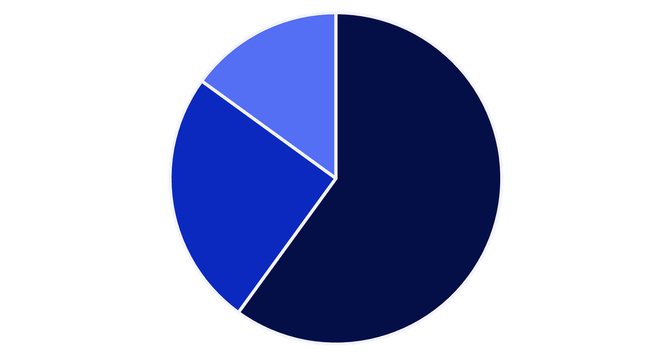
Database Management Systems (DBMS)
A Database Management System (DBMS) is software that allows users to define, create, maintain, and control access to a database. It acts as an interface between the database and end-users or application programs, ensuring data integrity, security, and efficient retrieval. Understanding DBMS is crucial for managing business information effectively.
Key Functions of DBMS
Data Storage & Retrieval: Efficiently stores and retrieves large volumes of data.
Data Integrity: Ensures data accuracy and consistency through validation rules.
Data Security: Provides mechanisms for access control and protection against unauthorized access.
Concurrency Control: Manages simultaneous access by multiple users without data corruption.
Backup & Recovery: Tools for data backup and restoration in case of system failures.
Relational DBMS
NoSQL DBMS
NewSQL & Others
Relational databases still dominate, but NoSQL and other modern DBMS types are gaining traction for specific use cases like big data and real-time applications.

Slide 10

Information Security and Cybersecurity
Information security focuses on protecting information from unauthorized access, use, disclosure, disruption, modification, or destruction. Cybersecurity is a subset that specifically deals with protecting digital systems and data from cyber threats. Both are paramount in an era of increasing digital dependency and sophisticated cyberattacks, safeguarding business assets and maintaining trust.
Confidentiality
Ensuring information is only accessible to authorized individuals.
Integrity
Maintaining the accuracy and completeness of data.
Availability
Ensuring authorized users have timely and reliable access to information.
Key Threats & Defenses
From phishing and malware to advanced persistent threats, organizations must deploy multi-layered defenses including firewalls, encryption, intrusion detection systems, and robust employee training programs to secure their digital landscape.

Slide 11


Cloud Computing
Cloud computing delivers on-demand computing services—from applications to storage and processing power—over the internet. This transformative approach allows businesses to leverage scalable and flexible IT infrastructure without the burden of direct ownership and maintenance. It is fundamental to modern digital operations, enabling innovation, enhancing collaboration, and significantly reshaping how organizations manage their technological resources and data.
Service Models
Deployment Models
Define how cloud resources are delivered:
Determine where the cloud infrastructure resides:
SaaS (Software as a Service): Cloud-based applications managed by a third party.
PaaS (Platform as a Service): A complete development and deployment environment in the cloud.
IaaS (Infrastructure as a Service): Fundamental computing resources like virtual machines, networks, and storage.
Public Cloud: Services offered over the public internet by third-party providers.
Private Cloud: Dedicated cloud infrastructure used exclusively by a single organization.
Hybrid Cloud: A mix of public and private clouds, connected to allow data and applications to be shared.
Business Benefits
Key advantages for organizations:
Scalability: Easily adjust resources up or down to meet demand.
Cost Efficiency: Reduces capital expenditure by paying only for consumed resources.
Flexibility: Enables remote access, agile development, and rapid innovation.

Slide 12
Emerging IT Technologies
The IT landscape is constantly evolving, with several emerging technologies poised to redefine business operations and strategic planning. Business analysts must stay abreast of these advancements to identify opportunities, mitigate risks, and guide organizations in leveraging them for competitive advantage.
Artificial Intelligence & Machine Learning
Internet of Things (IoT)
Blockchain Technology
A network of interconnected physical devices embedded with sensors and software, generating vast data for business optimization and real-time monitoring.
Decentralized, immutable ledger technology enhancing security, transparency, and traceability across transactions and supply chains.
Leveraging algorithms for data analysis, automation, and predictive insights, transforming decision-making and customer experiences.

Slide 13
Applications of IT in Business
Information Technology is integral to modern business operations, providing the tools and systems necessary to manage, optimize, and innovate across various functions. From managing customer relationships to streamlining supply chains, IT applications empower businesses to achieve greater efficiency, make data-driven decisions, and expand their market reach.
Customer Relationship Management (CRM)
Enterprise Resource Planning (ERP)
Supply Chain Management (SCM)
Optimizes the flow of goods and services from raw materials to final delivery, improving efficiency.
Streamlines customer interactions, sales, and support, enhancing satisfaction and loyalty.
Integrates core business functions like finance, HR, and manufacturing into a unified system.
Business Intelligence (BI) & Analytics
E-commerce
Transforms raw data into actionable insights, supporting strategic decision-making and performance monitoring.
Facilitates online buying and selling of products and services, expanding market reach and driving revenue.

Slide 14
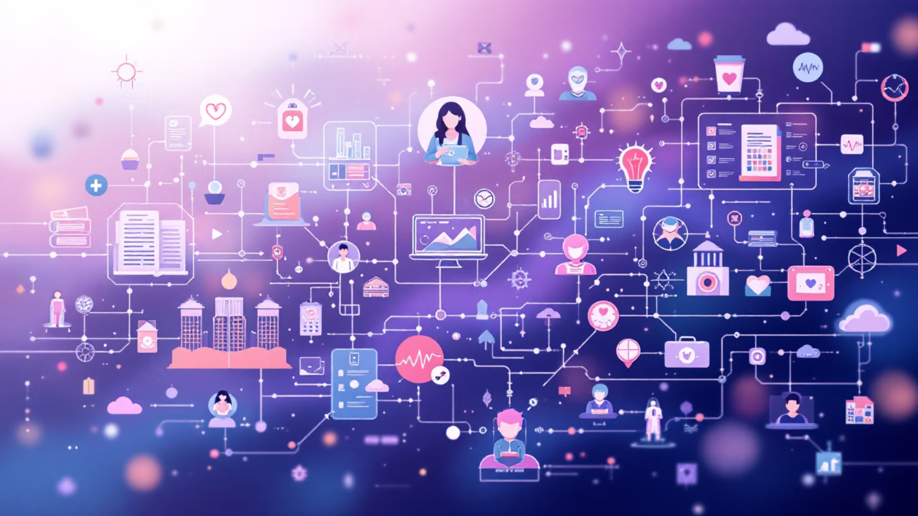
IT in Education and Society
Information Technology has profoundly transformed education and societal structures, democratizing access to knowledge, enhancing communication, and enabling advanced services that improve quality of life. Its pervasive influence continues to reshape how we learn, interact, and govern.
Transforming Education
Societal Impact
E-learning Platforms: Online courses, virtual classrooms, and learning management systems (LMS) making education accessible globally.
Interactive Tools: Digital whiteboards, educational apps, and simulations enhance engagement and personalized learning experiences.
Research & Collaboration: Facilitates access to vast digital libraries, academic databases, and global research collaborations.
Enhanced Communication: Social media and messaging apps connect people instantly across distances.
Healthcare Advancements: Telemedicine, electronic health records, and medical imaging improve diagnosis and patient care.
Smart Cities & Governance: Data-driven urban planning, public services, and citizen engagement through digital platforms.
Accessibility: Assistive technologies empower individuals with disabilities to participate more fully in digital society.

Slide 15

The Role of Information Technology in Modern Business
Information Technology is no longer merely a support function; it's a fundamental driver of strategy, growth, and competitive advantage across all sectors. Understanding its multifaceted role is crucial for business success in today's digital economy.
Strategic Enabler
Competitive Differentiator
Aligning technology with business objectives to achieve organizational goals and long-term vision.
Leveraging IT for unique products, services, and operational models that outpace rivals.
Innovation Catalyst
Operational Efficiency
Powering the development of new solutions, fostering creativity, and enabling continuous improvement.
Automating processes, reducing costs, and improving productivity across the entire enterprise.
Data-Driven Insights
Transforming raw data into actionable intelligence for informed decision-making and strategic planning.

Slide 16
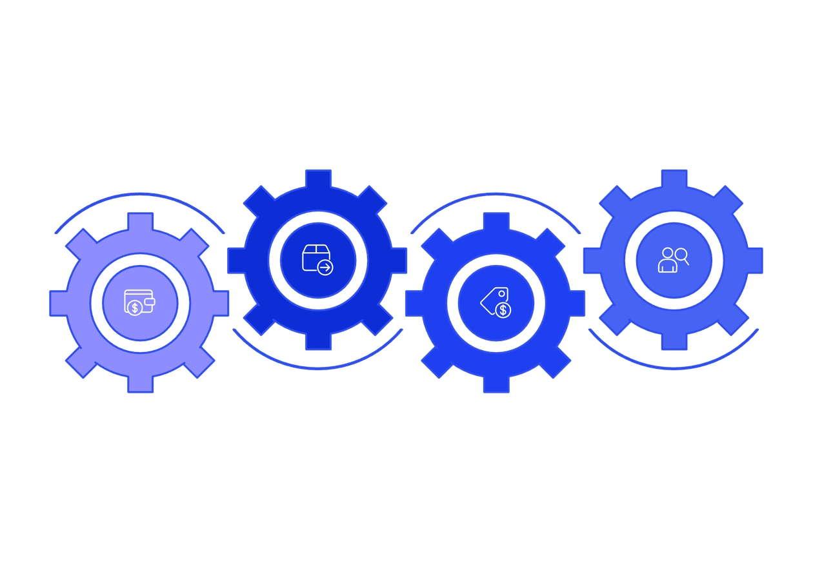
Enterprise Resource Planning (ERP)
Enterprise Resource Planning (ERP) systems are integrated software solutions that manage and integrate a company's essential business processes across departments. They serve as the central nervous system for an organization, consolidating information and streamlining operations from finance and HR to manufacturing and supply chain management.
Supply Chain
HR
Coordinate procurement and logistics
Manage people, payroll, and hiring
Finance
Sales
Manage budgets, ledgers, and reporting
Track orders, customers, and revenue
By providing a unified platform, ERP solutions eliminate data silos, enhance collaboration, and offer real-time insights, enabling better decision-making and improved operational efficiency.

Slide 17
Key Features of ERP Systems
ERP systems are designed with a comprehensive set of features to support diverse business operations, enhance efficiency, and provide a unified view of organizational data. These core functionalities are what make ERP an indispensable tool for modern enterprises.
Integrated Modules
Centralized Database
Combines various business functions (finance, HR, manufacturing, supply chain, CRM) into a single, cohesive system, eliminating data silos and improving collaboration.
All data is stored in a single database, ensuring data consistency, accuracy, and real-time access across all departments, facilitating better decision-making.
Process Automation
Reporting & Analytics
Automates routine and repetitive tasks across different modules, such as order processing, payroll, and inventory management, increasing efficiency and reducing human error.
Offers powerful reporting tools and analytics capabilities, providing insights into business performance, trends, and forecasts to support strategic planning and operational adjustments.
Data Security
Incorporates robust security features, access controls, and compliance management to protect sensitive business data and ensure adherence to industry regulations.

Slide 18
Core Modules in ERP
ERP systems are structured around a suite of interconnected modules, each designed to manage specific business functions. Together, these modules create a holistic platform that centralizes data, automates processes, and provides a unified view of organizational operations.
Financial Management
Human Capital Management (HCM)
Supply Chain Management (SCM)
Handles all financial transactions, including general ledger, accounts payable, accounts receivable, budgeting, and financial reporting, ensuring accurate and compliant financial operations.
Manages employee-related functions such as payroll, human resources, talent acquisition, performance management, and benefits administration, optimizing workforce efficiency.
Oversees the entire supply chain from procurement and inventory management to warehouse operations and logistics, ensuring timely delivery and cost efficiency.
Manufacturing & Production
Customer Relationship Management (CRM)
Supports all aspects of production, including planning, scheduling, bill of materials (BOM), shop floor control, and quality management, optimizing manufacturing processes.
Manages customer interactions, sales automation, marketing campaigns, and customer service, enhancing customer satisfaction and driving revenue growth.

Slide 19
Popular ERP Software Solutions
The ERP market offers a diverse range of solutions, each tailored to different business sizes, industries, and specific needs. Choosing the right ERP system is a critical strategic decision for any organization.
SAP ERP
Oracle ERP Cloud
The global market leader, offering comprehensive and highly customizable solutions for large enterprises across various industries.
A robust cloud-based suite providing financial management, project management, and supply chain capabilities for modern businesses.
Microsoft Dynamics 365
Infor ERP
An integrated suite combining ERP and CRM functionalities, best suited for organizations already leveraging Microsoft's ecosystem.
Offers industry-specific cloud ERP solutions, particularly strong in manufacturing, distribution, and public sectors.

Slide 20
How Enterprise Resource Planning Platforms Work
ERP systems fundamentally transform how businesses operate by integrating diverse functions onto a single platform. This enables seamless data flow, standardized processes, and a unified view of operations, driving efficiency and informed decision-making.
Data Consolidation
Cross-Functional Integration
All operational data from various departments is collected and stored in a single, unified database, eliminating information silos.
Different business modules (e.g., finance, HR, SCM) are seamlessly connected, allowing real-time sharing and access to the centralized data.
Automated Processes
Real-time Visibility
Key business workflows and routine tasks are automated across integrated modules, reducing manual effort, improving accuracy, and speeding up operations.
The unified platform provides up-to-the-minute insights and reporting across the organization, enabling swift, data-driven strategic and operational decisions.

Slide 21

The Power of a Centralized ERP Database
At the core of every effective ERP system lies a centralized database, serving as the single source of truth for all organizational data. This crucial component collects, stores, and manages information from every department and business process, ensuring consistency and accessibility across the enterprise.
By consolidating data into one unified repository, ERP systems eliminate the inefficiencies and risks associated with disparate systems, such as data duplication, inconsistencies, and delays. This integration fosters:
Enhanced Data Accuracy: A single database reduces the chances of errors and discrepancies that arise from multiple data entry points.
Real-time Insights: Up-to-the-minute data allows for prompt reporting and analytics, empowering quicker, more informed decision-making.
Improved Collaboration: All departments access the same current information, facilitating seamless communication and coordinated efforts.
Streamlined Operations: Standardized data and processes contribute to greater efficiency and faster workflow execution.

Slide 22
Integration of Business Processes
ERP systems act as a central nervous system for businesses, seamlessly connecting disparate functions and data points into a unified, coherent whole. This integration eliminates silos, streamlines workflows, and ensures all departments operate with a single source of truth.
Finance & Operations
Supply Chain & Manufacturing
Connects financial transactions, budgeting, and reporting with day-to-day operational activities like production and project management.
Integrates procurement, inventory, warehouse management, and production planning for optimized material flow and reduced lead times.
Sales & Customer Service
Human Resources & Payroll
Unifies customer data, sales orders, marketing campaigns, and service requests to enhance customer satisfaction and drive revenue.
Streamlines employee information, time tracking, expense management, and compensation processes for efficient workforce administration.

Slide 23
Automation of Tasks
ERP systems automate routine and complex tasks across departments, transforming operational efficiency and freeing up human capital for more strategic initiatives.
Streamlined Workflows
Enhanced Accuracy
Automating repetitive tasks like data entry, invoice processing, and report generation reduces manual effort and accelerates operations significantly.
By standardizing processes and minimizing human intervention, automation significantly lowers the risk of errors and data inconsistencies across the organization.
Increased Productivity
Faster Decision-Making
Employees are freed from mundane, administrative duties, allowing them to focus on strategic planning, analysis, and value-added problem-solving.
Automated data collection and real-time processing provide instant access to critical insights, enabling quicker responses to market changes and operational demands.

Slide 24
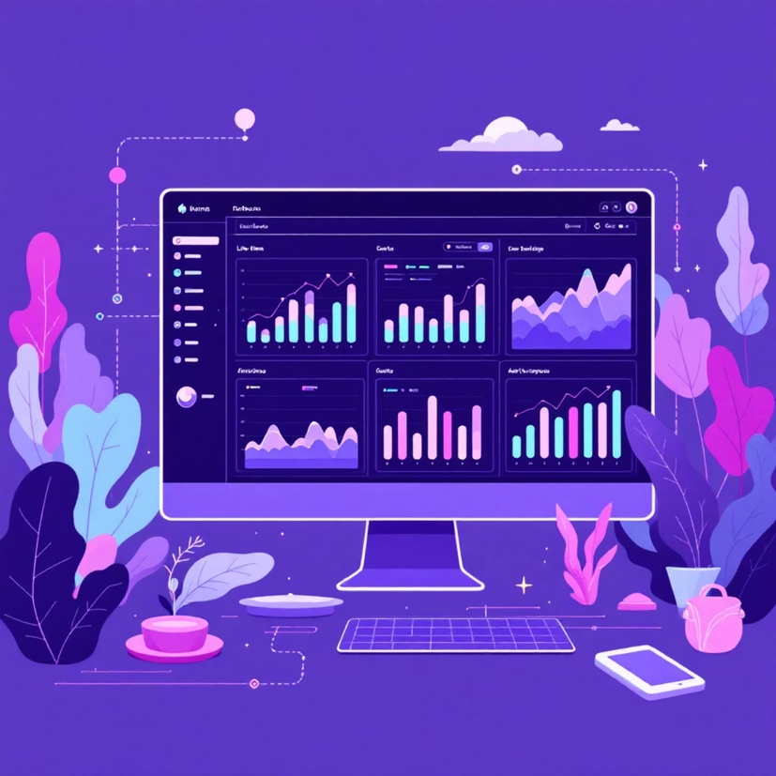
Real-Time Data and Reporting
One of the most transformative advantages of an integrated ERP system is its ability to provide real-time data and reporting. This ensures that stakeholders at all levels have immediate access to current, accurate information, empowering swift and strategic decision-making.
By continuously collecting and processing data from all departments, ERP platforms offer instant visibility into operational performance, financial health, and customer interactions. This immediate access facilitates:
Rapid Decision-Making: Respond quickly to market shifts, emerging trends, and unexpected challenges.
Enhanced Agility: Adapt business strategies and operations on the fly, maintaining a competitive edge.
Proactive Problem-Solving: Identify and address issues as they arise, before they escalate.
Optimized Performance: Continuously monitor key performance indicators (KPIs) and make data-driven adjustments for improved efficiency and profitability.

Slide 25
Modular Structure
ERP systems are built on a modular architecture, meaning they consist of independent yet integrated components that businesses can select and configure based on their specific needs. This approach allows for unparalleled flexibility and scalability.
Customization
Scalability
Organizations can choose relevant modules (e.g., finance, HR, manufacturing) to create a tailored system that precisely fits their operational requirements.
As business needs evolve, new modules can be easily added or existing ones expanded, allowing the ERP system to grow alongside the company without major overhauls.
Flexibility
Cost Efficiency
The modular design enables businesses to adapt quickly to market changes, adopt new technologies, or streamline processes by modifying specific components without disrupting the entire system.
Implementing only the necessary modules helps control costs by avoiding investments in features that are not currently required, with the option to expand later.

Slide 26
Cloud and On-Premise Deployment
Choosing the right deployment model for an ERP system is a critical decision that impacts costs, control, and IT infrastructure. The two primary options are cloud-based and on-premise, each with distinct advantages and considerations tailored to different business needs.
Cloud Deployment
On-Premise Deployment
In a cloud ERP model, the software and its associated data are hosted on a third-party provider's servers and accessed via the internet. This model offers flexibility and reduces the need for extensive in-house IT resources.
An on-premise ERP system is installed and runs on a company's own servers and infrastructure, managed internally by the organization's IT staff. This model provides maximum control over the system and data.
Lower Upfront Costs:
Scalability:
Automatic Updates:
Accessibility:
Full Control:
Customization:
Data Security:
Performance:

Slide 27
Security and Access Control
In an increasingly interconnected business environment, the security of sensitive data is paramount. ERP systems incorporate robust security and access control mechanisms to protect proprietary information, ensure data integrity, and safeguard against unauthorized access across all modules.
Data Encryption
Strong Authentication
Ensures all sensitive information, both at rest and in transit, is encoded to prevent unauthorized interception and maintain data confidentiality.
Verifies user identities through secure login protocols, often including multi-factor authentication (MFA) to prevent unauthorized access.
Role-Based Access Control
Audit Trails & Monitoring
Assigns granular permissions based on user roles, ensuring employees only access the data and functionalities relevant to their responsibilities.
Maintains comprehensive logs of all system activities, enabling tracking of data changes, user actions, and facilitating compliance audits.

Slide 28
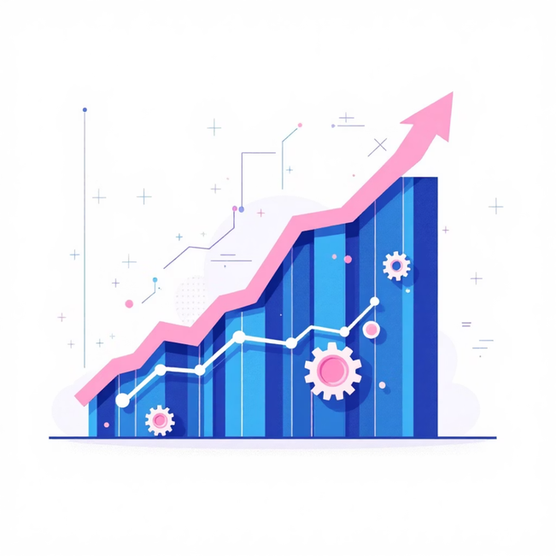
Continuous Updates and Scalability
Modern ERP systems are designed to evolve with your business, offering continuous updates to stay competitive and scalable architectures to support growth without disruption.
Scalability
A scalable ERP system can grow and adapt alongside your business, accommodating increased demands in terms of users, data, and operational complexity. Key aspects include:
User Growth: Easily add new users and expand access without performance degradation.
Data Volume: Handle exponentially larger datasets as your business generates more information.
Geographic Expansion: Support new locations, languages, and currencies seamlessly.
Module Addition: Integrate new modules or functionalities as business needs evolve.
Continuous Updates
ERP providers regularly release updates, patches, and new features to enhance security, improve performance, and introduce new functionalities. This ensures your system remains:
Secure: Protection against emerging cyber threats.
Feature-Rich: Access to the latest innovations and capabilities.
Compliant: Adherence to changing regulatory standards.
Optimized: Peak performance and efficiency.

Slide 29
Types of ERP
ERP systems are designed to cater to diverse business needs, often categorized by the specific industries they serve, the functionalities they offer, or the size of the organizations they target.
Industry-Specific ERP
General (Horizontal) ERP
Tailored with pre-built functionalities and compliance for sectors like manufacturing, retail, healthcare, or construction.
Broadly applicable solutions offering core modules that can be highly configured to suit various business models and industries.
Tiered ERP Solutions
Categorized by business size, offering robust functionalities for large enterprises (Tier 1) down to simplified solutions for SMBs (Tier 2/3).

Slide 30
Benefits of ERP
ERP systems offer a wide array of advantages that can transform business operations, driving efficiency, enhancing decision-making, and fostering growth across the organization.
Enhanced Operational Efficiency
Improved Data Visibility
Automates routine tasks, streamlines workflows, and reduces manual errors, leading to significant time and resource savings across departments and boosting overall productivity.
Provides a unified view of critical business data in real-time, enabling better insights and more informed decision-making across all levels of management.
Cost Reduction
Greater Scalability
Optimizes resource utilization, reduces operational waste, improves inventory management, and can lower administrative and IT costs in the long run.
Designed to adapt and grow with the business, ERP systems can easily accommodate increased users, data volumes, new functionalities, and geographic expansion without major disruptions.

Slide 31
ERP vs CRM
While both ERP (Enterprise Resource Planning) and CRM (Customer Relationship Management) systems are crucial for business operations, they focus on different aspects and serve distinct purposes. Understanding their differences is key to optimizing business processes and customer interactions.
ERP (Enterprise Resource Planning)
CRM (Customer Relationship Management)
ERP systems are designed to manage and integrate core business processes across an organization. They focus on internal operational efficiency by centralizing data from various departments.
CRM systems concentrate on managing a company's interactions with current and potential customers. Their primary goal is to improve business relationships, driving sales growth and enhancing customer satisfaction.
Focus: Internal business processes and operational efficiency.
Goal: Streamline finance, HR, manufacturing, and supply chain.
Users: Employees across all departments (finance, operations, HR).
Key Functions: Financial management, supply chain, production planning, inventory control.
Focus: External customer interactions and relationships.
Goal: Improve sales, marketing, and customer service.
Users: Sales, marketing, and customer service teams.
Key Functions: Lead management, sales automation, customer support, marketing campaigns.

Slide 32



The Relationship between Business Strategy, IT Strategy, and Alignment Capability
The effective integration of business goals with technology implementation is paramount for modern organizations. This requires a clear understanding of each component and their symbiotic relationship.
Business Strategy
IT Strategy
Strategic Alignment
Defines the organization's overarching goals, objectives, and desired market position. It guides all major decisions and resource allocation, focusing on market opportunities and competitive advantage.
Outlines how information technology will be leveraged to support, enable, and accelerate the achievement of business goals. It encompasses technology investments, infrastructure, applications, and digital initiatives.
The crucial capability to harmonize IT initiatives with business objectives, ensuring technology investments directly contribute to competitive advantage, operational efficiency, and overall value creation. It's the bridge between vision and execution.

Slide 33



How Business Strategy, IT Strategy, and Alignment Capability Work Together
The symbiotic relationship between business strategy, IT strategy, and strategic alignment forms a continuous loop, where each component influences and reinforces the others to drive organizational success.
IT Strategy Enables
Develops technological solutions and infrastructure to achieve business goals, creating capabilities and efficiencies.
Business Strategy Drives
Sets the overall direction and objectives, identifying market opportunities and competitive differentiators that technology must support.
Alignment Optimizes
Ensures IT initiatives are directly linked to business outcomes, maximizing value, mitigating risks, and fostering innovation.

Slide 34
The Alignment Cycle
Strategic alignment is not a one-time event, but a dynamic and continuous cycle that requires ongoing attention and adaptation to ensure technology consistently supports and advances business objectives.
Define Business Goals
Develop IT Strategy
Clearly articulate organizational vision, strategic priorities, and desired outcomes, setting the direction for all subsequent actions.
Design technology roadmaps, architectures, and initiatives that directly enable and enhance the defined business goals, identifying necessary investments and capabilities.
Execute & Integrate
Monitor & Adapt
Implement IT projects and solutions, ensuring seamless integration with existing processes and systems, and fostering collaboration between business and IT teams.
Continuously assess the performance of IT initiatives against business metrics, gathering feedback, identifying gaps, and making necessary adjustments to maintain alignment and drive continuous improvement.

Slide 35

Difference between Structured, Semi-structured and Unstructured Data
A concise overview: Structured data is highly organized (tables, rows, columns) and easy to query. Semi-structured data has tags or markers (JSON, XML) providing some organization but flexible schemas. Unstructured data lacks predefined structure (documents, images, audio, video, social posts) and requires advanced processing to extract meaning.

Slide 36
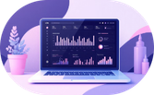
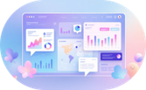

Common Data Sources
Internal Systems
Third‑Party Analytics
External & Open Data
ERP, CRM, HR systems and operational databases — mostly structured; primary source for transactions and customer records.
Behavioral and market analytics from vendors — semi-structured feeds and reports used for benchmarking and segmentation.
Public datasets, geospatial data, regulatory filings and open APIs — varied formats, often semi-structured or unstructured.

Slide 37


What Do Business Analysts Do?
Business analysts bridge business needs and technical solutions. They elicit requirements, translate problems into clear specifications, prioritize work, validate that solutions meet objectives, and measure outcomes to drive continuous improvement.
Typical outcomes: clearer requirements, reduced rework, measurable ROI, and better stakeholder alignment.

Slide 38

Key Responsibilities
1. Elicit Requirements
Facilitate interviews, workshops, and surveys to capture stakeholder needs and constraints.
2. Analyze & Model
Create process maps, user stories, and data models to clarify current and future states.
3. Communicate & Validate
Produce clear specifications, acceptance criteria, and prototypes for stakeholder sign‑off.
4. Measure Impact
Define KPIs, analyze results post‑release, and recommend iterative improvements.

Slide 39

Skills of a Business Analyst
Analytical thinking: data interpretation and root-cause analysis
Communication: concise writing, stakeholder facilitation, and presentation
Modeling: process maps, data models, and user journeys
Technical familiarity: SQL, APIs, data formats (JSON, XML)
Business acumen: domain knowledge and translating strategy to requirements

Slide 40

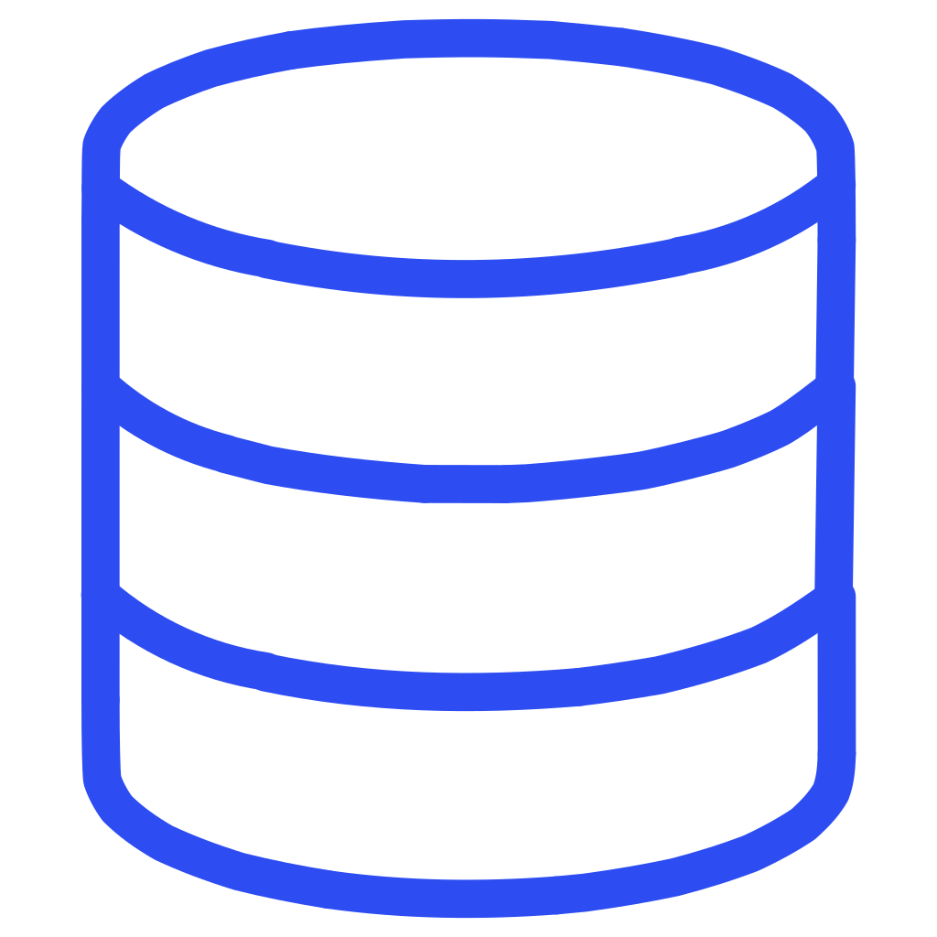
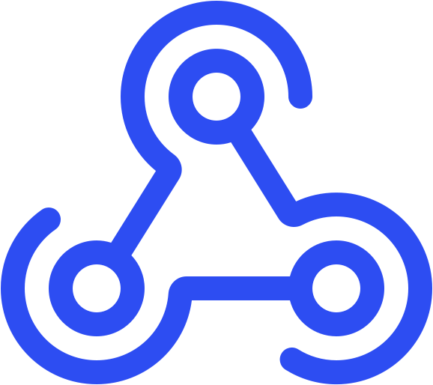


The Tools Used by Business Analysts
Databases & SQL
Data Formats & APIs
Query structured data for insights and validation.
Work with semi-structured feeds and integrate services.
Modeling & Diagramming
Collaboration Platforms
Tools for process maps, ER diagrams, and flowcharts (e.g., Lucidchart, Visio).
Jira, Confluence, Teams — manage requirements, workflows, and traceability.

Slide 41

Collaboration & Relationship‑Building
Successful analysis depends on trust and clear communication. BAs cultivate cross‑functional relationships with stakeholders, product owners, developers, QA and operations to ensure needs are understood, prioritized, and delivered with quality.
Empathy
Negotiation
Transparency
Understand user pain points and motivations.
Balance scope, time, and cost to reach pragmatic decisions.
Communicate trade-offs and progress honestly.

Slide 42
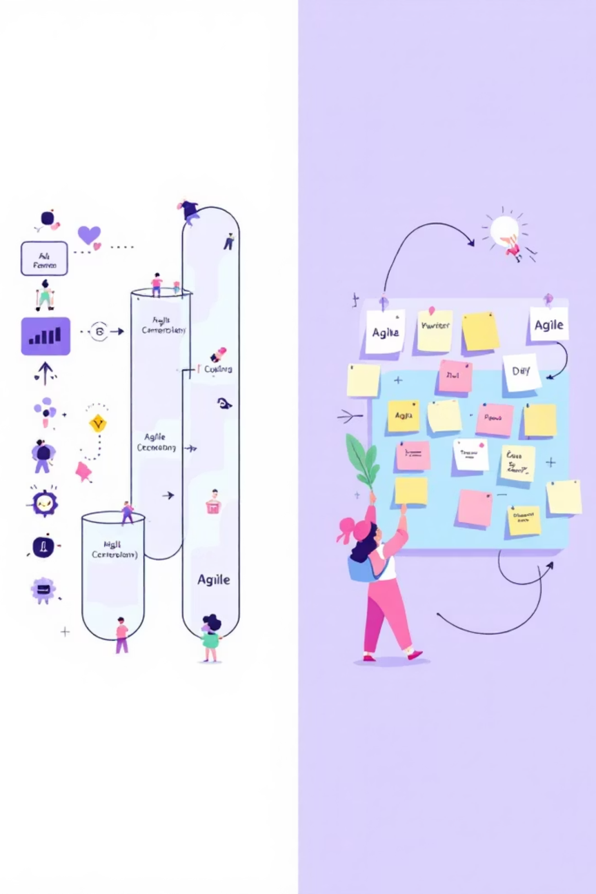
Business Analysis Methodologies
BAs adapt methods to context: Waterfall for predictable, fixed-scope projects; Agile for iterative delivery and frequent feedback; Hybrid approaches combine upfront analysis with incremental execution. Choose the approach that matches risk, clarity, and stakeholder cadence.

Slide 43
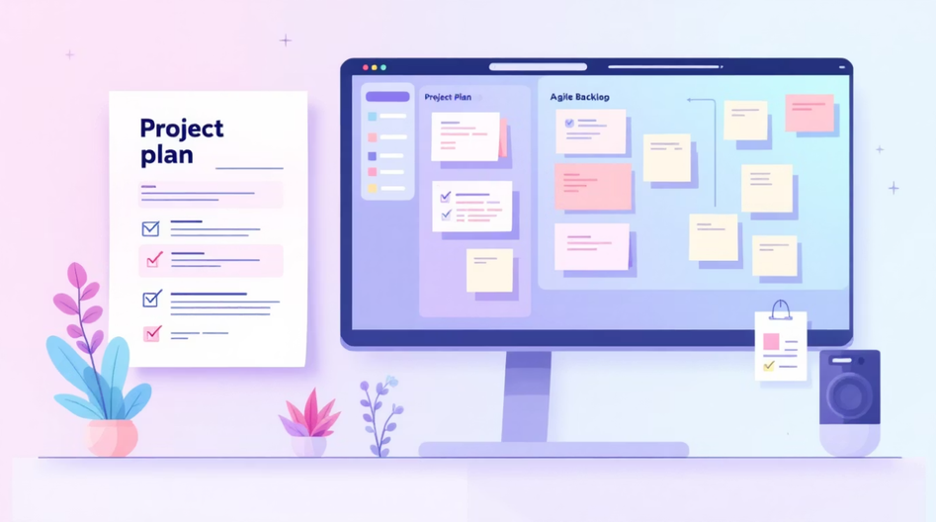
Key Differences: Waterfall vs Agile
1
Planning
Waterfall: heavy upfront planning. Agile: incremental planning each sprint.
2
Delivery Rhythm
Waterfall: single delivery at end. Agile: frequent, incremental releases.
3
Change Management
Waterfall: change is costly. Agile: embraces change via feedback loops.
Use this comparison to select the right delivery model: Waterfall for regulatory or fixed-scope projects; Agile when discovery, user feedback, or changing requirements drive value.
4
Stakeholder Involvement
Waterfall: periodic reviews. Agile: continuous collaboration and demos.

Slide 44

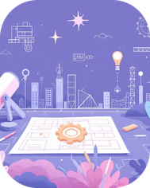

When to Use Waterfall
Regulatory & Compliance Projects
Engineering & Construction
Fixed‑Price Contracts
Clear requirements and fixed deliverables reduce risk when adherence to laws or standards is mandatory.
Well-defined scope and sequential dependencies favor a linear approach.
When scope, timeline, and budget are agreed in advance and change is expensive.
Final note: even in Waterfall contexts, incorporate validation gates and stakeholder reviews early to reduce late-stage surprises.

Slide 45

When to Use Agile
Evolving Requirements
Ideal for projects where initial needs are unclear or expected to shift, enabling flexibility and continuous adaptation.
Rapid Iteration & Feedback
When frequent delivery of working software and continuous stakeholder feedback are critical for validating solutions early.
Complex & Innovative Projects
Best for tackling intricate problems or developing entirely new solutions where discovery, learning, and incremental build are essential.
Strong Team Collaboration
Empowers cross-functional teams to self-organize, communicate directly, and take shared ownership of project outcomes.
Agile methodologies thrive in dynamic environments by prioritizing customer value and embracing change throughout the development lifecycle.

Slide 46

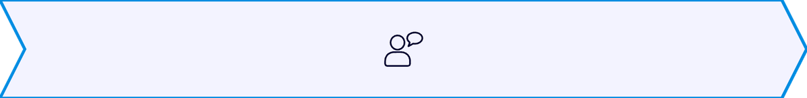


Stakeholder Management
Effective stakeholder management is crucial for project success. Business Analysts actively identify, analyze, and engage with stakeholders to ensure alignment, manage expectations, and facilitate smooth project delivery.
Identify & Analyze
Communicate & Engage
Pinpoint key stakeholders, assess their influence, interest, and potential impact on the project.
Establish clear communication plans, provide regular updates, and foster open dialogue to build trust.
Negotiate & Resolve
Monitor & Adapt
Mediate conflicting priorities, address concerns, and guide stakeholders towards mutually beneficial solutions.
Continuously track stakeholder satisfaction, anticipate changes, and adjust engagement strategies as needed.
By proactively managing relationships, BAs minimize resistance and maximize support, steering projects toward successful outcomes.

Slide 47

The Benefits of Stakeholder Management
Effective stakeholder management is not just about avoiding problems; it actively contributes to project success by maximizing collaboration and minimizing friction. It ensures that projects deliver value that truly meets the needs and expectations of all involved parties.
Greater Project Success
Stronger Relationships
Achieve project goals more consistently by ensuring all parties are aligned and working towards a common vision.
Build trust and foster positive working relationships, leading to increased cooperation and commitment.
Reduced Risks & Conflicts
Better Decision-Making
Proactively identify and address potential issues and disagreements, leading to smoother project execution.
Incorporate diverse perspectives and expertise, leading to more robust and informed project decisions.

Slide 48





Key Aspects of Stakeholder Management
Effective stakeholder management encompasses more than just communication; it's a strategic approach to ensuring all parties contribute positively to project outcomes. Focusing on these core aspects helps Business Analysts navigate complex dynamics and foster a collaborative environment.
PROACTIVE IDENTIFICATION
Don't wait for issues to arise; identify all relevant stakeholders, including those with indirect influence, from the project's inception.
TAILORED COMMUNICATION
Adapt communication styles, frequency, and content to meet the specific needs and preferences of diverse stakeholder groups.
MUTUAL UNDERSTANDING
Work to achieve a shared understanding of project objectives, scope, risks, and benefits among all involved parties to prevent misalignments.
CONFLICT RESOLUTION
Address disagreements and conflicting priorities promptly, fairly, and transparently, seeking mutually beneficial solutions to maintain momentum.
CONTINUOUS ENGAGEMENT
Stakeholder needs and influence can change. Maintain ongoing dialogue and re-evaluate engagement strategies throughout the project lifecycle.
Mastering these aspects enables BAs to build robust support systems, ensuring that projects align with organizational goals and deliver maximum value.

Slide 49
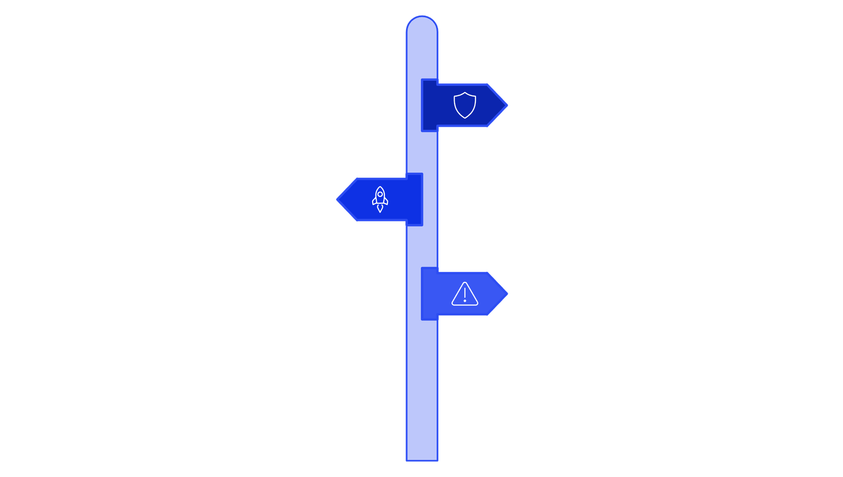



What Is Scenario Analysis?
Scenario analysis is a strategic planning method that evaluates the potential impacts of various future events or conditions on a business, project, or decision. It involves creating several plausible, yet distinct, future scenarios to understand their implications rather than predicting a single outcome.
Conservative Path
Slow growth with controlled risks and steady recovery.
Optimistic Path
Rapid expansion driven by innovation and strong demand.
Disruptive Path
Major upheaval from unexpected shocks or market shifts.

Slide 50





Key Aspects of Scenario Analysis
Scenario analysis is a robust tool for strategic foresight, enabling organizations to navigate uncertainty by understanding potential futures. Its effectiveness hinges on several core components:
Identifying Key Drivers
Crafting Plausible Scenarios
Pinpoint the critical internal and external factors (e.g., technology, market shifts, regulations) that will most significantly influence future outcomes.
Develop a few (typically 2-4) distinct, internally consistent narratives of how the future might unfold, considering different combinations of drivers.
Assessing Impacts
Developing Adaptive Strategies
For each scenario, evaluate its potential effects on the business's objectives, resources, competitive landscape, and overall performance.
Formulate flexible strategies and contingency plans that are robust enough to succeed across various scenarios, not just one predicted future.
Monitoring & Adapting
Track key indicators that signal which scenario is becoming more likely, allowing for timely adjustments to strategies and plans.
By focusing on these aspects, businesses can develop more resilient strategies and make informed decisions in the face of an uncertain future.

Slide 51





How Scenario Analysis is Used
Scenario analysis is a versatile tool applied across various sectors to anticipate change and build resilience. It helps organizations prepare for a range of possible futures rather than relying on a single forecast.
Strategic Planning
Risk Management
Investment Decisions
Develop robust strategies that hold true across different future environments, ensuring long-term adaptability and competitive advantage.
Identify potential threats and opportunities associated with various scenarios, enabling proactive mitigation and contingency planning.
Evaluate investment opportunities and project viability under different market conditions, optimizing resource allocation and minimizing financial risk.
Policy Development
Innovation & R&D
Assess the potential impacts of new policies, regulations, or societal shifts, informing more effective and sustainable decision-making.
Explore future market needs, technological advancements, and consumer behaviors to guide research and development efforts toward relevant solutions.
By simulating diverse outcomes, businesses and policymakers can make more informed decisions, fostering resilience and driving innovation in an unpredictable world.

Slide 52


What Is Data Governance?
Data governance establishes the framework for managing data assets, ensuring they are high-quality, secure, compliant, and accessible for effective decision-making. It defines roles, responsibilities, and processes for data use across an organization.
Data Quality
Data Security
Data Privacy
Ensuring accuracy, completeness, consistency, and timeliness of data to support reliable insights.
Implementing measures to protect data from unauthorized access, breaches, or misuse.
Managing sensitive information in compliance with legal regulations and ethical guidelines.
Data Standards
Data Stewardship
Establishing common definitions, formats, and rules for data to ensure interoperability and understanding.
Assigning accountability for managing and overseeing specific data assets throughout their lifecycle.
By formalizing data management practices, organizations can enhance trust in their data, reduce risks, and unlock its full strategic potential.

Slide 53
Key Elements of Data Governance
Effective data governance relies on a comprehensive framework built upon several interconnected elements. These components work together to ensure data is a strategic asset, managed efficiently and responsibly.
Data Quality
Data Security
Ensuring data is accurate, complete, consistent, and timely, which is fundamental for reliable analysis and decision-making.
Implementing robust measures to protect data from unauthorized access, breaches, and cyber threats, safeguarding organizational integrity.
Data Privacy
Data Architecture
Adhering to legal regulations (like GDPR and CCPA) and ethical guidelines regarding the collection, storage, and use of personal and sensitive data.
Defining and maintaining the structural design for how data is acquired, stored, integrated, and made accessible across all enterprise systems.
Data Stewardship
Data Lifecycle Management
Assigning clear roles and responsibilities for data ownership, ensuring accountability for data quality, security, and usage throughout its lifecycle.
Governing data from its creation and capture through its use, archival, and eventual disposal, optimizing storage and ensuring compliance at each stage.
By establishing strong practices around these elements, organizations can build trust in their data assets, reduce risks, and unlock their full potential for strategic advantage.

Slide 54
Benefits of Data Governance
Data governance is a cornerstone for modern organizations, yielding significant advantages beyond mere compliance. It transforms data from a potential liability into a powerful asset, driving strategic success and operational excellence.
Improved Data Quality
Enhanced Compliance & Security
Ensures data is accurate, complete, and consistent across all systems, providing a reliable foundation for analysis and reporting.
Helps meet regulatory requirements (e.g., GDPR, CCPA) and internal policies, protecting sensitive information and mitigating legal and reputational risks.
Informed Decision-Making
Operational Efficiency
Empowers leaders with trustworthy, high-quality data, enabling them to make more confident, strategic decisions that drive growth and innovation.
Streamlines data processes, reduces data duplication and errors, and optimizes resource utilization, leading to significant time and cost savings.
Increased Trust & Transparency
Builds confidence among stakeholders regarding the integrity and accessibility of data, fostering better collaboration and accountability across the organization.
By establishing a robust data governance framework, organizations can unlock their data's full potential, creating a competitive advantage in today's data-driven landscape.

Slide 55


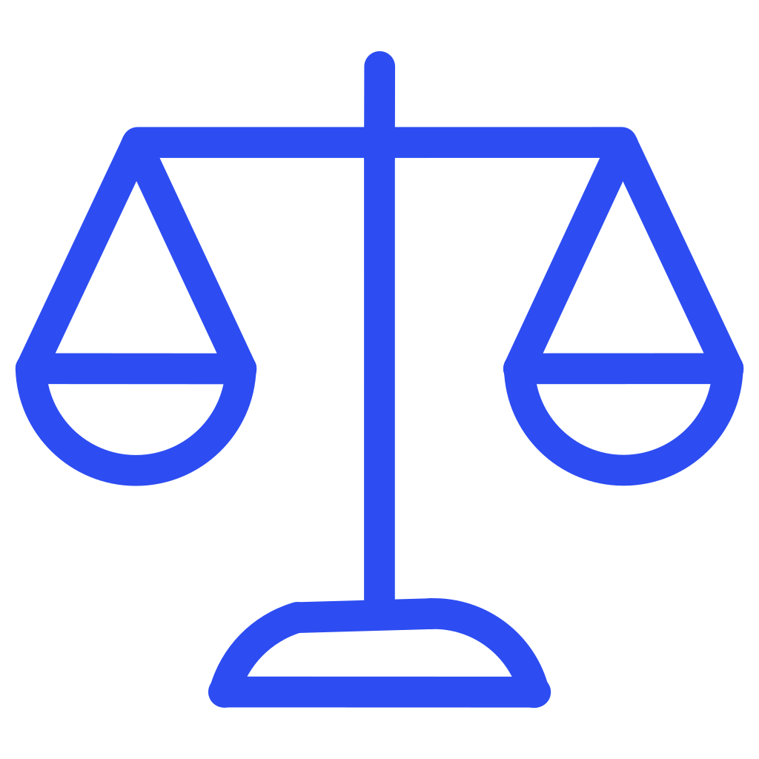

What is the Ethical Use of Data?
Ethical data use involves handling information responsibly, ensuring it serves individuals and society while upholding values like fairness, transparency, and privacy. It extends beyond legal compliance to embrace moral principles in data collection, storage, analysis, and application.
Transparency
Privacy
Being open and honest with individuals about how their data is collected, used, and shared.
Protecting personal information and respecting individuals' control over their data.
Fairness & Bias Mitigation
Accountability
Ensuring data practices do not lead to discrimination or perpetuate existing societal biases.
Establishing clear responsibilities and mechanisms for organizations to be held accountable for their data handling practices.
Consent
Obtaining explicit and informed permission from individuals before collecting or processing their data.
By embedding these ethical considerations into data strategies, organizations can foster trust, mitigate risks, and build sustainable relationships with their stakeholders.

Slide 56
CCPA vs GDPR compliance: Similarities and Differences
Both the California Consumer Privacy Act (CCPA) and the General Data Protection Regulation (GDPR) aim to grant individuals greater control over their personal data. While sharing common goals, they differ significantly in their scope, definitions, and enforcement, creating a complex landscape for global businesses.
GDPR (General Data Protection Regulation)
CCPA (California Consumer Privacy Act)
Scope: Applies globally to any entity processing personal data of EU residents, regardless of the entity's location.
Definition of Personal Data: Broad, covering any information relating to an identified or identifiable natural person.
Consent: Requires explicit, unambiguous, and freely given consent for data processing.
Key Rights: Right to access, rectification, erasure (right to be forgotten), data portability, and objection to processing.
Enforcement: Administered by Data Protection Authorities (DPAs) in each EU member state.
Penalties: Up to €20 million or 4% of annual global turnover, whichever is higher.
Scope: Applies to businesses meeting specific thresholds (e.g., gross annual revenues over $25 million) that process personal information of California residents.
Definition of Personal Information: Broader than GDPR's, including household information and inferences drawn from other data.
Consent: Primarily an "opt-out" model, allowing consumers to stop the sale or sharing of their data.
Key Rights: Right to know what data is collected, delete data, and opt-out of the sale or sharing of personal information.
Enforcement: Enforced by the California Privacy Protection Agency (CPPA) and the California Attorney General.
Penalties: Up to $7,500 per intentional violation and $2,500 per unintentional violation, plus private right of action for data breaches.
While both regulations serve as benchmarks for data protection, understanding their nuanced differences is crucial for businesses aiming for compliance in an increasingly regulated digital world. Many organizations often build a compliance framework that addresses the stricter requirements of both.

